Slide 1



#Spszurich
#crmsaturday
SharePoint + CRM Saturday Zurich 2017
SharePoint Framework the new development way
Giuliano De Luca / @giuleon

Slide 2











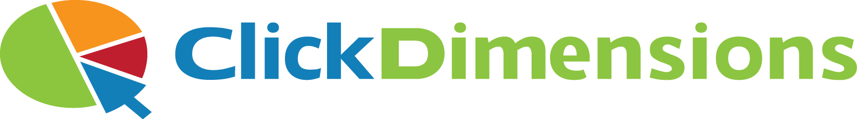






Slide 3




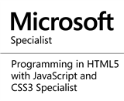



Giuliano De Luca
SharePoint + CRM Saturday Zurich
May 13, 2017
Software Engineer | Office 365 | Blogger
www.delucagiuliano.com
giuliano.deluca@outlook.com
@giuleon

Slide 4
Agenda
SharePoint Framework
Toolchain
Office UI Fabric
SharePoint Framework Considerations
Resources

Slide 5
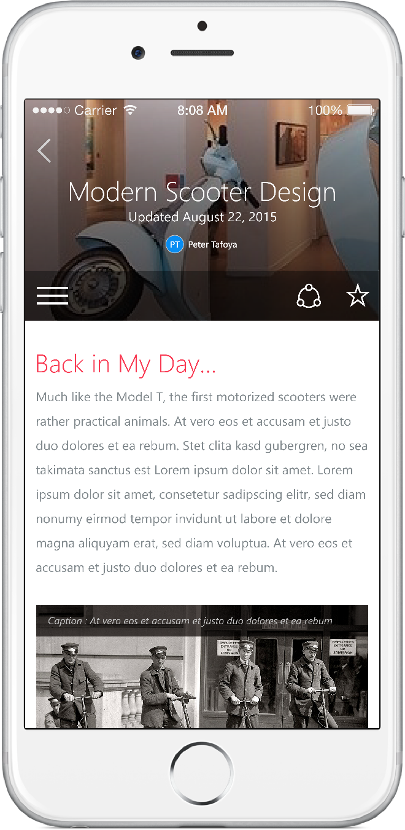
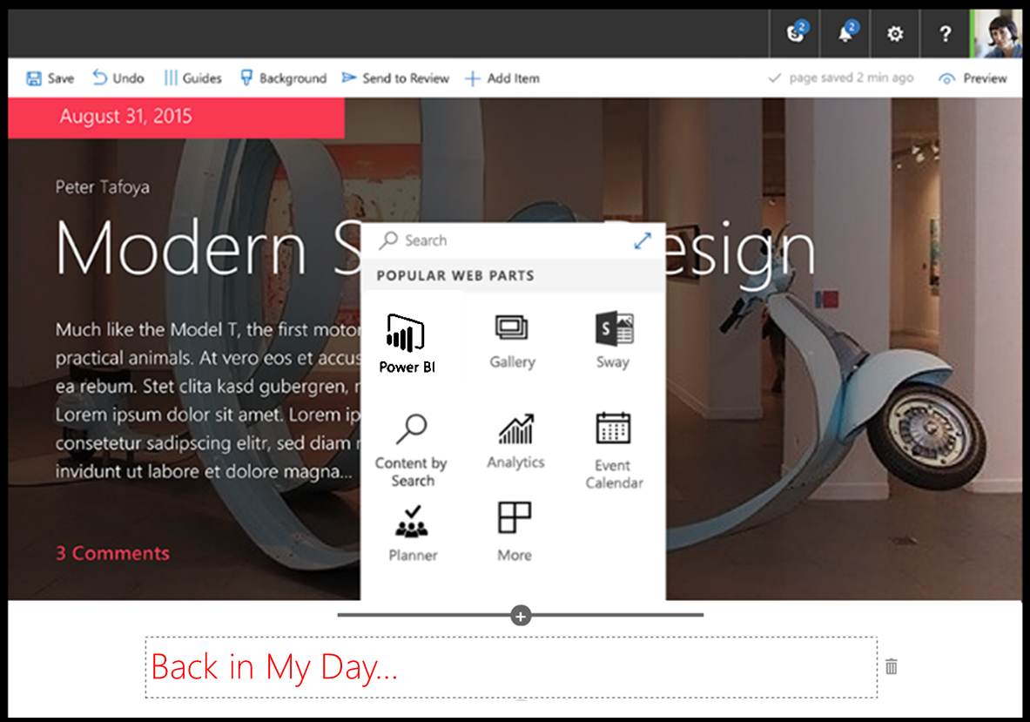
SharePoint Framework
Already available on SharePoint Online
In the future also for SharePoint On-Prem 2016
Modern client-side development
Lightweight web and mobile
Powers our own experiences
Backward compatible
Supports open source tools and JavaScript web frameworks
SharePoint framework
Microsoft Graph
LOB Systems and Cloud Services

Slide 6





SharePoint Framework Toolchain
Tooling
Node.js
Yeoman
Gulp
TypeScript
Visual Studio (Code)
Frameworks – Choose yours
React
Angular.js
Knockout
Etc.

Slide 7



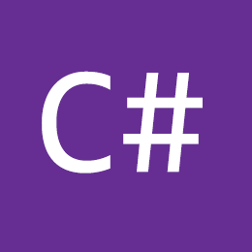
Comparing tools with Microsoft
IIS Express
MS Build
VS Project →
New → <Template>

Slide 8
What is Node.js?
Run server-side JavaScript
Makes use of Google’s V8 JavaScript engine
Supports the latest ECMAScript features
Open source
Cross-platform
“Can” act as a web server, but more is possible
Check your version: node -v

Slide 9
What is npm?
JavaScript package manager
Similar like NuGet
Install and manage dependencies / modules
npm init
npm install <package_name>

Slide 10
Why using Gulp?
Transpiling TypeScript > JavaScript / SASS > CSS
Building debug / production packages
Uploading files to CDN / FTP / SharePoint
Execute tasks after file changes
Warming-up scripts

Slide 11
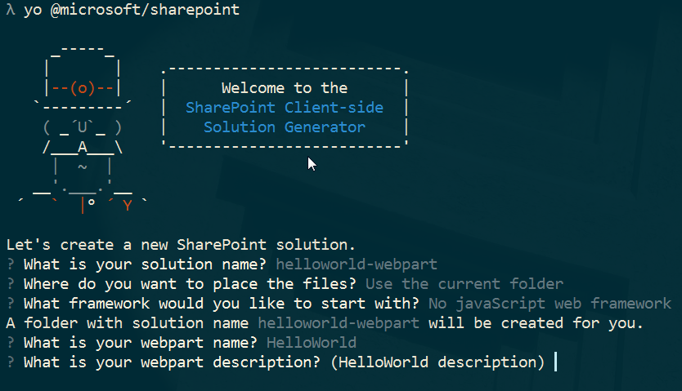
Yeoman: the web's scaffolding tool for modern webapps

Slide 12
Bullet list of most useful gulp command
Tasks | Purpose
gulp serve | Serving the local development environment (--nobrowser is optional)
gulp build | Builds the project (transpiling) → check “lib” folder
gulp test | Runs the unit tests if you have written any
gulp bundle | gulp | Build project in DEBUG mode → check “dist” folder
gulp bundle --ship | gulp --ship | Build project in SHIP mode / ready for distribution → check “temp” folder
gulp package-solution | Packages the DEBUG solution as an app package → check “sharepoint” folder
gulp package-solution --ship | Packages the production ready solution → check “sharepoint” folder
gulp deploy-azure-storage | Add the files to your Azure CDN
gulp clean | Cleans the project from build artifacts (remove previous builds)
gulp trust-dev-cert | Add a developer certificate to your client → necessary for local development
gulp untrust-dev-cert

Slide 13
Demo
Hello Word Web Part

Slide 14


Modern UI
Ohh Nooo ! I’m not a designer
"Keep calm and use Office UI Fabric“ - Satya Nadella
Wait a minute Giuliano, I never said this….

Slide 15
Office UI Fabric
Front-End Framework
Responsive and mobile-first
Office 365 User Experience
Support to React, Angular, JS and IOS
Many components available
Open source

Slide 16
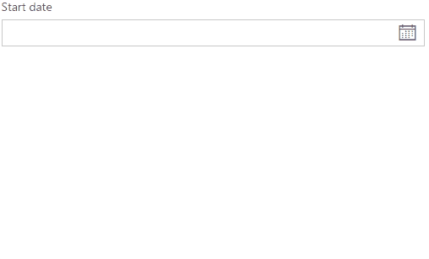
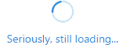
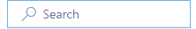
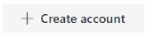

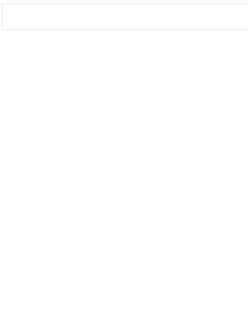
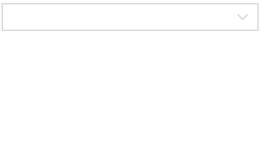
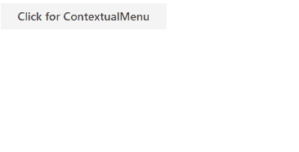
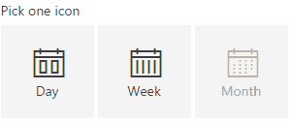
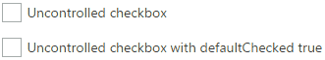
Components

Slide 17
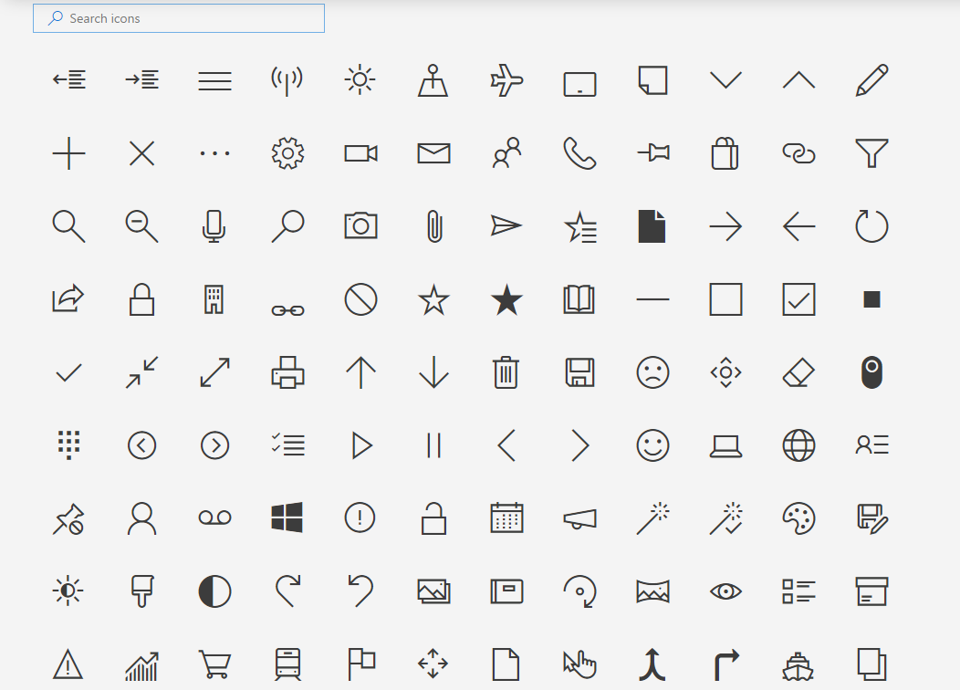
Icons
708 Icons available

Slide 18

Open source
React
Fabric’s robust, up-to-date components are built with React
Fabric JS
Lightweight and simple components in vanilla Javascript
AngularJS
Community-driven project for Angular apps
Fabric IOS
Native iOS styling and components written in Swift
https://github.com/OfficeDev/Office-UI-Fabric
https://dev.office.com/fabric

Slide 19
Main Office UI Fabric features
Responsive grid
Localization
Colors
Icons
Animations
Typography

Slide 20
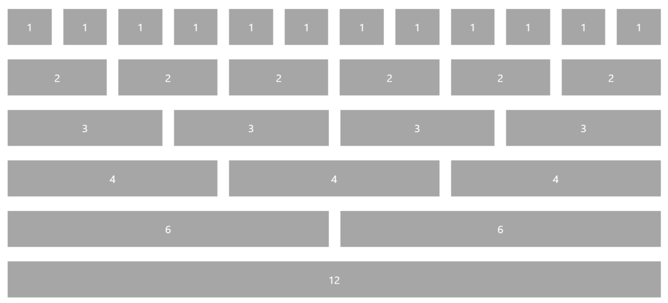
Office UI Fabric Grid

Slide 21
Office UI Fabric classes
Class Name | Range | Breakpoint
ms-u-smxx | 320px - 479px | Small
ms-u-mdxx | 480px - 639px | Medium
ms-u-lgxx | 640px - 1023px | Large
ms-u-xxx | 1024px - 1365px | Extra Large
ms-u-xxxx | 1366px - 1919px | Extra Extra Large
ms-u-xxxxx | 1920px and up | Extra Extra Extra Large

Slide 22
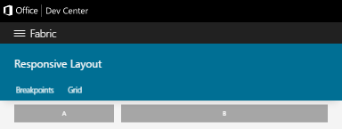
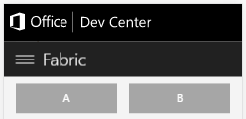
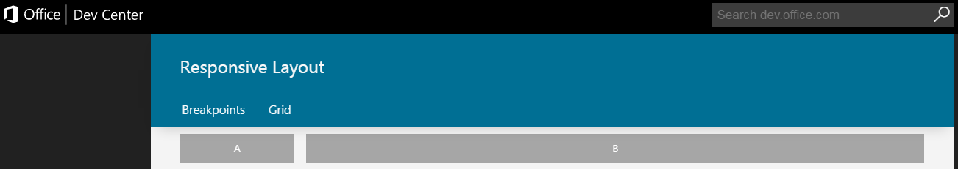
Office UI Fabric grid sample
<div class="ms-Grid">
<div class="ms-Grid-row">
<div class="ms-Grid-col ms-u-sm6 ms-u-lg4 ms-u-x2">A</div>
<div class="ms-Grid-col ms-u-sm6 ms-u-lg8 ms-u-x10">B</div>
</div>
</div>

Slide 23
Demo
Web Part + Office UI Fabric

Slide 24
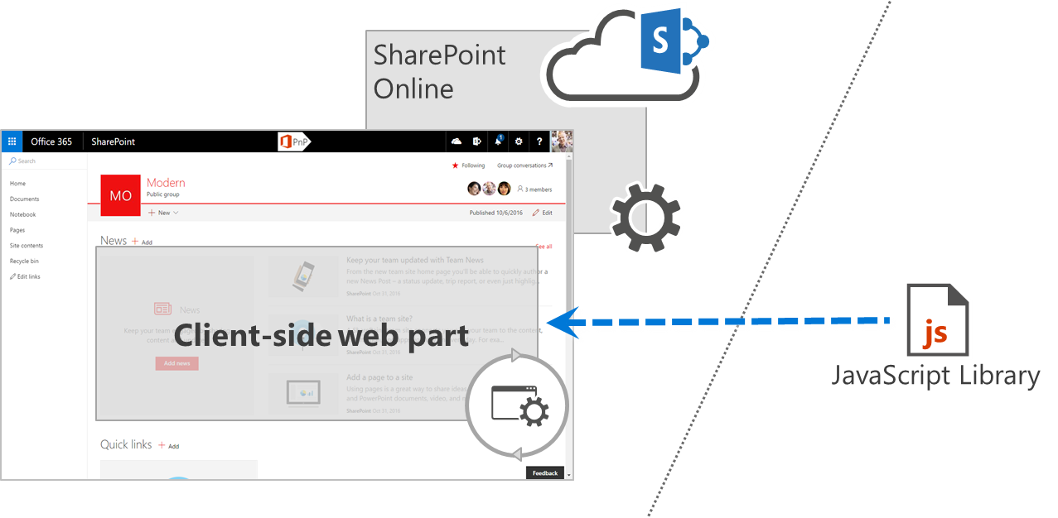
Anatomy of a SharePoint Framework solution
Azure CDN
SharePoint Online CDN
Other CDN

Slide 25
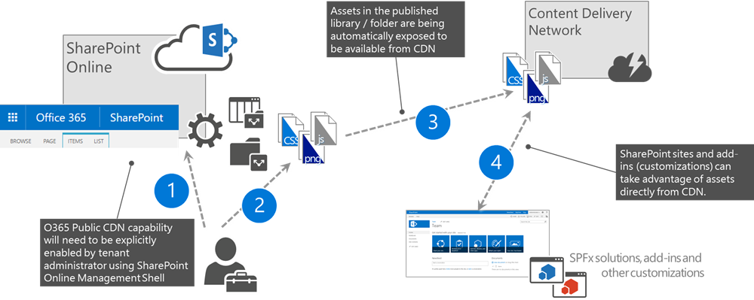
CDN considerations
https://publiccdn.sharepointonline.com/<tenant host name>/<ID of the public CDN origin>/<sub-path under the origin>/

Slide 26
Security considerations
SPFx solutions are running in the context of user
You can always use also add-in model with oAuth model
Script integrity in context of hosting location
‘No script’ options for extra security of your site

Slide 27
Client-side customizations in SharePoint
SPFx
Add-ins
Script editor web part
Script embedding
Solutions are deployed centrally as a tenant admin
JavaScript is executed with the permissions of end user
Isolated functionalities hosted either in iframe or outside of the SharePoint
Scripts are added on the pages by end users
Scripts can be hosted anywhere
Same with content editor web part
Embedding scripts with Usercustomactions or JSLink
JavaScript files can be added by site owners using API
JS files hosted in the site
Characteristics
Works on ‘no-script’ sites
Permissions model
Centralized approval

Slide 28


Debug considerations
Of course not, you will go in debug using ever typescript.
So I'll write my code in typescript and do I have to debug in javascript ? That's not really comfortable.

Slide 29
Debugging options
Use your browser developer tools
Using the debugger statement -> „debugger;“
Debugging in Visual Studio Code

Slide 30


Slide 31

Thank You !
Giuliano De Luca

Slide 32
Resources
SPFx People Picker - https://goo.gl/iRZZd7
SharePoint Add-In People Picker - https://goo.gl/SEUflx
SPFx All property types - https://goo.gl/Y46vkA
SPFx React chart web part - https://goo.gl/NmRG7j
SPFx React weather web part - https://goo.gl/uXnZJd
SharePoint Framework - https://goo.gl/SJ1VHW
Office UI Fabric - https://dev.office.com/fabric
http://www.delucagiuliano.com

